Slide 1
Secure and Efficient Multi-variant Execution Using Hardware-assisted Process Virtualization 2016 46th Annual IEEE/IFIP International Conference on Dependable Systems and Networks
Koen Koning/Vrije Universiteit Amsterdam
Herbert Bos/Vrije Universiteit Amsterdam
Cristiano Giuffrida/Vrije Universiteit Amsterdam

Slide 2
Outline
Introduction
System Design & Implementation
Evaluation
Conclusion

Slide 3
Outline
Introduction
System Design & Implementation
Evaluation
Conclusion

Slide 4
Multi-variant Execution(1/2)
Multi-variant Execution(MVX) is an intrusion detection mechanism that executes several slightly different versions or variants of the same program in lockstep
MVX is a promising technique to detect arbitrary memory error exploits(e.g., buffer overflow) via divergent behavior
Lockstep:
In Lockstep, the system will run multiple processes which contain the same set of operations at the same time and synchronize the state across the processes.

Slide 5
Multi-variant Execution(2/2)
Every MVX system contains two major components:
A MVX monitor
Variant generation strategies.
MVX monitor is responsible for:
Synchronizing the execution of the running process variants
Intercept the syscalls and their arguments to compare process behaviors
Variants generation strategies:
Unconstrained variation makes it impossible to detect attacks from divergence, as everything may be different.
Insufficient variation is also undesirable, as there may not be any divergence for an attack.
Notes:
Intercept syscalls:
It must also be able to rewrite arguments, block syscalls, and modify
the return value (or memory) to ensure uniform and side effect free
syscall handling across all the variants. In general, the monitor needs
to ensure all the variants are exposed to the same environment view
and information (e.g., PIDs) to avoid unintentionally divergent behavior.
(避免控制外的分歧行為出現)

Slide 6
Threat model
Arbitrary code execution
An attacker could execute arbitrary code(e.g., issuing an “execve” syscall using ROP or other code-reuse techniques)
Information disclosure
An attacker could leak sensitive data from the target program.(e.g., Heartbleed)
Information tampering
An attacker could tamper with sensitive data such as UIDs to escalate privileges, or mount other non-control-data attacks
Notes:
Cryptographic keys as in the case of Heartbleed

Slide 7
Outline
Introduction
System Design & Implementation
Implementation
Evaluation
Conclusion

Slide 8
MvArmor
MvArmor is a efficient and secure MVX system based hardware-assisted process virtualization.
The system is implemented on top of Dune to provides security guarantees against memory error exploits and protect commodity Linux programs
A MVX system which allow users to make trade-offs between security and performance.

Slide 9
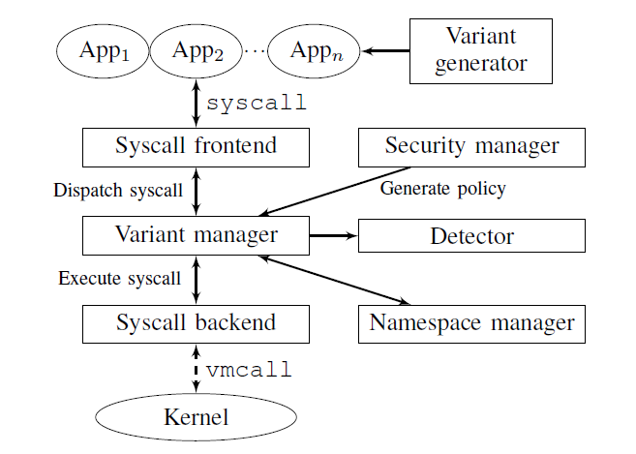
System Overview

Slide 10
Variants generator
How to generate the variants?
A fundamental question is to what extent the variants should differ.
Using non-overlapping address spaces/offset strategy across variants
Vary the address space layout (offset) and keep everything else(e.g.,PID) the same.
The pointer can only be in valid at most one variants and the other variants would crash.
There are two type of generated variants, leader and followers.
The leaders use the default address space allocator
The followers use the custom address space allocator
Ensure the allocated address space and offset are non-overlapping
Using a modified version of libumem ,a slab allocator.(for non-overlapping address)
By limiting the number of objects allowed per slab and adding padding (i.e., the leader’s maximum heap size) to every slab, non-overlapping offset spaces between leader and followers can be enforced.

Slide 11
Security manager
Security manager is responsible for generate policy
Code execution:
enforce full checks on “execve” and “mprotect/mmap” with execute permissions set.
Information disclosure:
enforce full checks on I/O syscalls that are able to leak data (e.g., write).
Comprehensive:
Full check on all syscalls.

Slide 12
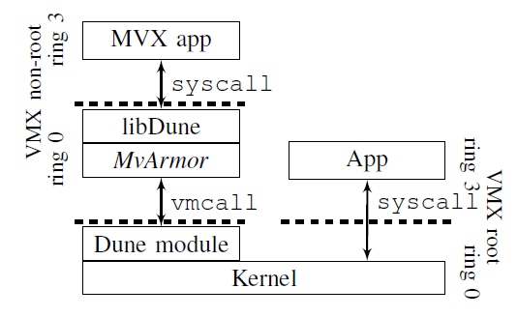
Syscall frontend*
With Dune, whenever the application executes a syscall instruction, the execution will trap from ring 3 into ring 0—kernel space.
The syscall frontend is responsible for :
The access to application state
forwarding the received syscall which traps from libDune to variants manager
Guest kernel
Host kernel
Not all syscalls incur a trap incur a trap on modern Linux
In every application, the kernel sets up a shared library (the virtual dynamic shared object—i.e.,vDSO), which contains code to execute a selection of syscalls without trapping into the kernel.
Using Dune, we can still intercept vDSO calls, by mapping our own code containing syscall instructions in place of the original vDSO

Slide 13
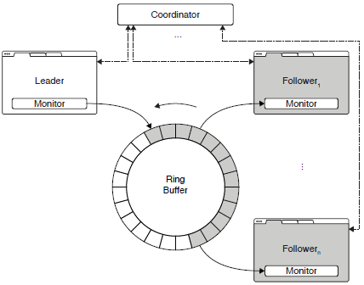
Variants manager (1/2)
When receiving a syscall event from the frontend, the variants manager synchronize with the other variants.
Specifically, the variant manager has a per-syscall table to determine the appropriate behavior.
Certain syscalls should execute only once (e.g., socket-related syscalls), while others should execute in every variant (e.g., memory management calls). For the former, the followers simply copy the return value of the leader.
How to perform the synchronization between variants?
Every process has a ring buffer it shares with the respective processes in other variants.
The leader will push the process into the buffer with its arguments and return value.
The followers compare their arguments with those of the leader.
Either execute the syscall themselves, or use the return value provided by the leader.

Slide 14
Variants manager (2/2)
Certain syscalls should execute only once (e.g., socket-related syscalls), while others should execute in every variant (e.g., memory management calls). For the former, the followers simply copy the return value of the leader.
For muti-threaded applications, the followers are forced to adhere to the order of syscall of the leader.
By performing this loose form deterministic threading(DMT) to prevent divergent behavior due to non-deterministic scheduling.
In some cases, it is necessary to adopt more strict form of DMT to prevent unintentionally divergent behavior.
E.g., divergence due to benign data race
Notes:
Data race
1.two or more threads in a single process access the same memory location concurrently
2.at least one of the accesses is for writing
3.the threads are not using any exclusive locks to control their accesses to that memory

Slide 15
Syscall backend
When a variant needs to execute a syscall, it forwards the call to the syscall backend.
After receiving the call, the syscall backend will either forward the syscall to (host)kernel ,or tries to execute the syscall locally.
This is currently implemented for memory management syscalls
MVX monitors can be susceptible to time-of-check-totime-of-use (TOCTOU) attacks, where an attacker modifies the arguments of a syscall in memory from a different thread after the arguments are checked by the monitor but before they are read by the kernel.
By directly passing the pointers to the copied data structures (in the monitor) to the kernel. Because no additional copying is required
Notes:
This works because the arguments passed
to the syscalls are usually pointers to buffers or structures in the address space of the application, copied separately by
the monitor (for checking) and the kernel (for execution).

Slide 16
Namespace manager(1/3)
The namespace manager ensures the variants do not diverge accidentally by eliminating all variant-specific information.
Except for the address space layout, the following information must be the same:
PID/UID
File descriptors
Timing information
Random number generation

Slide 17
Namespace manager(2/3)
PID/UID
Virtual PIDs and UIDs will be assigned to every process and thread using hierarchical structure.
for example, when a variant creates threads , these must get the same virtual TID in all variants
file descriptors
Create virtual file descriptors and only the leader has access to all of them.
Maintain a mapping of virtualized file descriptors to real(per-variants) file descriptors.
Notes:
if variants were to have access to their kernel assigned PIDs or timing information, they may (directly or
indirectly) use such data in a conditional, leading to divergent behavior.
For instance, followers do not have access to sockets or files opened as writable. Since the kernel assigns file descriptors in an incremental fashion
per process and the followers open fewer files (e.g., read only files) than the leader, these numbers start to diverge

Slide 18
Namespace manager(3/3)
Timing information
The authors disable the “rdtsc” instruction by intercept vDSO syscall
Random number generation
Only leader to open files like “/dev/random”
Limit access to the “/proc” file system to the leader
Configure the virtual environment to trap into the hypervisor when the “rdrand” instruction is executed.
(Option)Disable “rdrand” instruction by disabling corresponding bit in the “cupid” implementation of the hypervisor
Notes:
if variants were to have access to their kernel assigned
PIDs or timing information, they may (directly or
indirectly) use such data in a conditional, leading to divergent
behavior.

Slide 19
Detector
Since a syscall can take no more than six arguments, many calls expect pointers to data structures(e.g., buffer or struct) which hold more information.
For a full comparison between variants, the MvArmor will perform deep semantic copy and comparison of such arguments.

Slide 20
Outline
Introduction
System Design & Implementation
Evaluation
Conclusion

Slide 21
Server performance
The authors selected nginx, lighttpd, bind and beanstalkd ,which are heavily exposed to attack, for their experiments.
Nginx and lighttpd(high-performance web server)
Using the wrk benchmark issuing 10 seconds worth of requests for a 4 KB page over 10 concurrent connections.
Bind(a popular name server)
Using the queryperf benchmark issuing 500,000 requests with 20 threads.
Beanstalkd(a work queue)
Issuing 100,000 push operations per worker over 10 concurrent connections and 256 bytes of data.

Slide 22
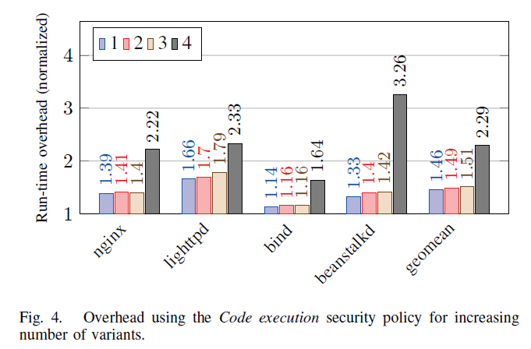
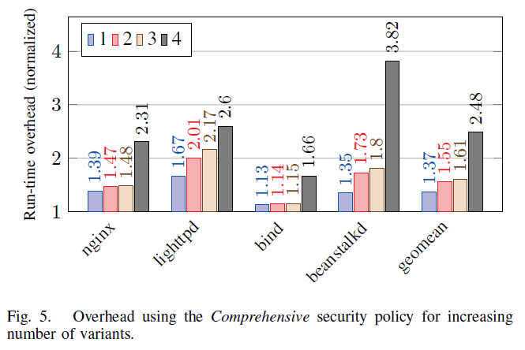
Server performance - results
Programs with a lower number of “copy-heavy” syscalls such as nginx and lighttpd scale less efficiently with the number of variants and are also more affected by the increasingly lockstep-like behavior enforced by more conservative security policies

Slide 23
Server performance - results
Beanstalkd, on the other hand, issues relatively few syscalls overall and the reported overheads are mostly due to the copying costs for Beanstalkd’s large buffers.

Slide 24
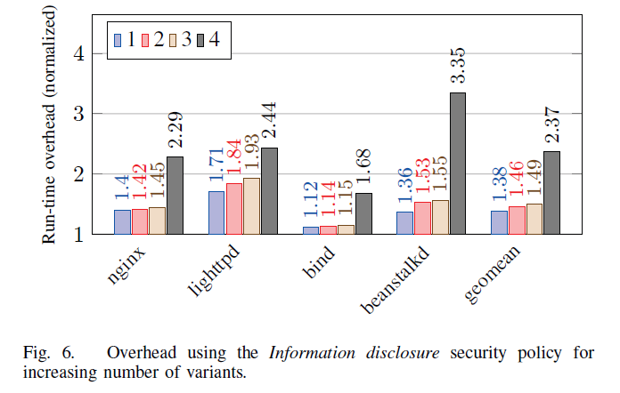
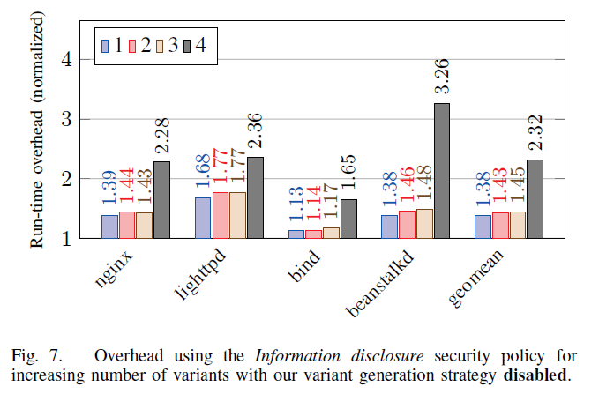
Server performance - results
When enabling our variant generation strategy (isolating the MVX synchronization overhead) for the same policies, there are little more additional overhead in the results.

Slide 25
Comparison with Varan
Focus on the Code execution strategy
MvArmor’s performance is very similar to Varan for nginx (41% vs. 37% for 2 variants, respectively)
For beanstalkd, MvArmor show relatively low and stable overheads for MvArmor (∼41%) and increasingly higher overheads for Varan (52% and 57%, for 2 and 3 variants, respectively).
For lighttpd, Varan reports low and nearly constant overheads (∼14%), while MvArmor’s overheads start at 70% for 2 variants.

Slide 26
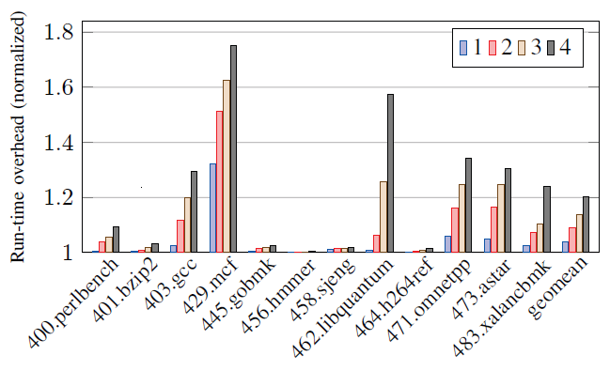
SPEC performance(1/2)
The reported overheads primarily originated by the impact on the memory bandwidth of the system. Benchmarks such as mcf and libquantum are particularly memoryintensive and tend not to scale well in simultaneous runs on multi-core architectures.

Slide 27
SPEC performance(2/2)
Despite the greater impact of TLB misses in memory-intensive benchmarks induced by the use of EPTs in Dune. MvArmor still yield better performance than Varan on the same sets of benchmarks
MvArmor V.S. Varan (9.1%(geomean) V.S. 14.2%(geomean) )

Slide 28
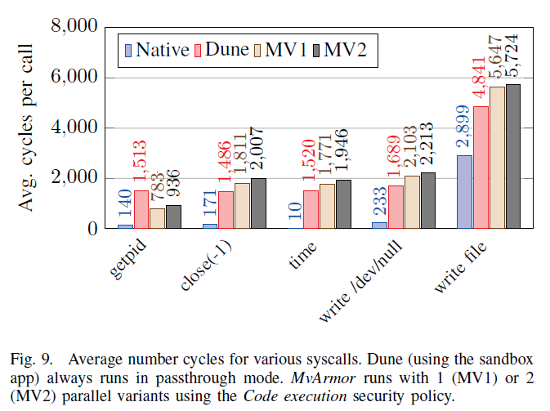
Microbenchmark

Slide 29
Microbenchmark
Both the getpid and close(-1) syscalls have a very short duration, with the kernel almost immediately returning to userland.
Dune alone adds around 1,300 cycles, accounting for syscall interposition and (mostly) for the vmcall to the host.
MvArmor add around 300 extra cycles on top of Dune
As the "getpid" syscall is currently implemented in MvArmor’s backend, it does not require an expensive vmcall

Slide 30
Microbenchmark
The write syscall has a buffer argument, which first undergoes bounds checking in Dune and then requires copying the buffer in MvArmor’s monitor.
For a small 5-byte buffer,Dune alone adds around 1,500 cycles, while MvArmor adds around 400 (/dev/null) and 800 (filesystem) extra cycles.
The time syscall, part of the vDSO, can natively be executed without a syscall instruction, but Dune remaps the vDSO to force traps into the monitor (add around 1500 extra cycles).

Slide 31
Security
Memory error exploits that rely on absolute addresses are deterministically prevented by MvArmor’s non-overlapping address spaces across variants.
Range from modern code-reuse attacks to information disclosure
Memory error exploits that rely on relative addresses are also deterministically prevented by MvArmor’s MVX-aware allocator(non-overlapping offset) design deployed in the follower(s).

Slide 32
Case1 : CVE-2014-0160
The vulnerability in the OpenSSL library
This exploit overreads a buffer located on the heap to read security-sensitive data from other heap objects and eventually allow the program to leak them over the network.
the attacker can only read data from the leader because of the non-overlapping offset spaces. Any attempt to read the object in the follower(s) as well would require reading a size larger than the leader’s heap, causing the leader to read past its heap and crash.

Slide 33
Case2 : CVE-2014-0195
The vulnerability in the OpenSSL library
The vulnerability allows an attacker issuing a long non-initial fragment to overflow a heap-allocated buffer and corrupt adjacent data.
As mentioned in previous slides ,any attempt to “spray” this much data would again result in protection faults in at least one of the variants.

Slide 34
Outline
Introduction
System design & Implementation
Evaluation
Conclusion

Slide 35
Limitation
MvArmor’s custom allocator is subject to Dune’s restrictions on the maximum per-process virtual memory size.
MvArmor can only protect generic heap objects, it cannot decouple intra-struct buffers or chunks managed by custom memory allocators
MvArmor prototype to support arbitrary multi-threaded applications faces two challenges:
Supporting thread safety in Dune (currently thread-unsafe)
When benign data races are present (i.e., threads synchronizing without syscalls such as futex) preserving correct MVX semantics with a more strict form of DMT.

Slide 36
Conclusion
MVX monitor design leverages hardware-assisted process virtualization to securely and efficiently gain full control over the running program variants.
MvArmor’s policy-driven detection strategy can provide strong and flexible security guarantees at the cost of relatively low run-time overhead for such a comprehensive security solution.
MvArmor can match the performance of the fastest MVX (Varan) implementation available while providing far stronger security.

